Slide 1
Estilos de vida
HiP HOP - Rap

Slide 2
Hip Hop History
Hip Hop is an artistic and cultural movement composed of a broad conglomerate of artistic forms, originating within a marginal subculture in the south Bronx and Harlem in new york city among Young latinos and african americans durging 1970S. IT IS ChARACTERIZED by four elements, which represent the different manifestasions of the culture: Rap, turntblism or ‘’djing’’ , breaking and graffiti

Slide 3

Hip Hop Origin
The roots of hip-hop can be found in African American music and finally in African music. The griots of West Africa are travelers who are part of an oral tradition that goes back hundreds of years. His vocal style is similar to that of rappers. Emerged in the United States in the late 1960s in the African American and Latin American communities of New York's popular neighborhoods such as Bronx, Queens and Brooklyn

Slide 4

RAP
Dance music style born in the 1980s in the black and Hispanic neighborhoods of New York and other major American cities as a derivation of funk and associated with hip-hop culture; Is characterized by its monotonous and very syncopated rhythm, its long texts sung almost monologically and its radical lyrics on topics such as violence, the fight against the established system, sex, machismO or work.

Slide 5

Turntablism – ‘’ djing ‘’
Turntablism (also called DJing) is the art of arranging or creating music by using sound effects and manipulating the routines of rotating and reading vinyl records on a turntable. Turntablism could be translated as "the art of spinning" the tables "

Slide 6

Breaking or break dance
The Breaking or Bboying, is an urban dance that is part of the African American culture emerged in the communities of the New York boroughs like Bronx and Brooklyn in the decade of 1970. Although it was certain that it reached the highest recognition the years 1980, thanks to The influence of diverse artists like James Brown or Michael Jackson, and films like Breakin 'and Beat Street that extended the movement towards European and Latin American countries.

Slide 7
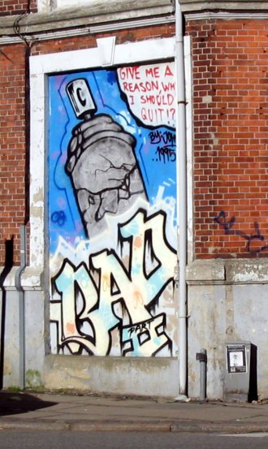
GRAFFITI
In common language, graffiti is the result of painting abstract texts on the walls in a free, creative and unlimited way for expression and dissemination purposes where their essence is to change and evolve; Seeking to be a visual attraction of high impact, as part of a revolutionary and rebellious urban movement. It is one of the four elements that forms the Hip Hop culture

Slide 8
Some exponents of hip hop
- Run-D.M.C
- Kanye West
- Eminem
- Beastie Boys
-J ay-Z
- Public Enemy
- 2Pac
- Snoop Dogg
- Missy Elliot
- Dr. Dre
- Afrika Bambaataa
- 50 cent
- NOTORIOUS B.I.G
- GURU

